Slide 1

Minor Research Project on Appraisal of Artwork using Machine Learning
Anushka Joshi Guide: Dr. Rishi Gupta
209301149
Vatsal Tripathi
209301424

Slide 2
Problem Statement
The problem statement for this project is how accurately we can predict the value of artwork based on a variety of factors using machine learning.
The challenge lies in developing a machine learning model that can faithfully capture the details of the art market and generate consistent and dependable values.

Slide 3

Objective
The objective of this project is to develop a machine learning model to predict the price of artwork. The model will be trained on a dataset of past artwork sales.

Slide 4
Research Paper used for Reference:
Source Information | Salient Features | Link
Department of Computer Science, Stony Brook University | Features used: a) Colour Palette Score : For this we used k-means colour quantization to reduce the colours in an image. In this algorithm, we use the K-means algorithm to cluster pixels based on similar colours and reduce the total number of colours to a pre-defined number b) Is Portrait : A pre-trained Haar-cascade classifier for face detection in the image c) Smoothness Score : Canny edge detector on the image, and found out the number of pixels in the image corresponding to an edge d) Brightness Score : Changed the image colour space from RGB to YUV, because Y-channel corresponds to the luminosity of the image. | https://www3.cs.stonybrook.edu/~skiena/591/final_projects/art_acution/Team4_Final_Report.pdf
CS230, Deep Learning, Stanford University | Methods: a) Baseline model: Linear regression model using textual/numerical data b) Multilayer perception model using textual/numerical data includes 11 hidden layers, with 64 neuron units c) Convolutional neural network models using image data d) Fused model using bimodal data of textual/numerical features and images. Results: The fused models utilizing bimodal data of textual/numerical data and image data outperforms both the models using only textual/numerical data and the models using only image data. The convolutional neural network models using only images performed relatively poorly to other types of models. | https://cs230.stanford.edu/projects_fall_2019/reports/26261328.pdf
Painting2Auction: Art Price Prediction with a Siamese CNN and LSTM, Stanford University | Methods: a) Siamese Neural Networks: Evaluating the efficacy of several different CNN architectures for evaluating the similarity of two paintings, judged by their accuracy on the binary classification task("same artist" or "different artist") with the Kaggle dataset. Each CNN is individually incorporated into a Siamese Neural Network b) KNN: This model predicts the price of an input painting by taking the median of the price values of the k paintings closest to the input out of a pool of the n most-recently-auctioned paintings, where k and n are hyperparameters and "closest" is judged with the Siamese CNN c) LSTM: This model predicts the price of an input painting by taking the median of the price values of the k paintings closest to the input out of a pool of the n most-recently-auctioned paintings, where k and n are hyperparameters and "closest" is judged with the Siamese CNN. | http://cs230.stanford.edu/projects_fall_2020/reports/55539436.pdf
Machines and Masterpieces: Predicting Prices in the Art Auction Market | Variables Used: a) Artist and artist nationality- more than 100,000 distinct artists in the training data. Together, these artists represent 168 different nationalities. b) Artwork creation year c) Artwork size- Width and height are included in the database for nearly all observations. We winsorize these size variables at the 0.5% lowest and highest values in each year. d) Artwork markings- Creating three dummy variables that equal one if the artwork is (1) signed; (2) dated; or (3) inscribed by the artist. These categories are not mutually exclusive e) Artwork title f) Artwork materials. | https://damore-mckim.northeastern.edu/wp-content/uploads/2019/04/Northeastern_Spaenjers.pdf

Slide 5
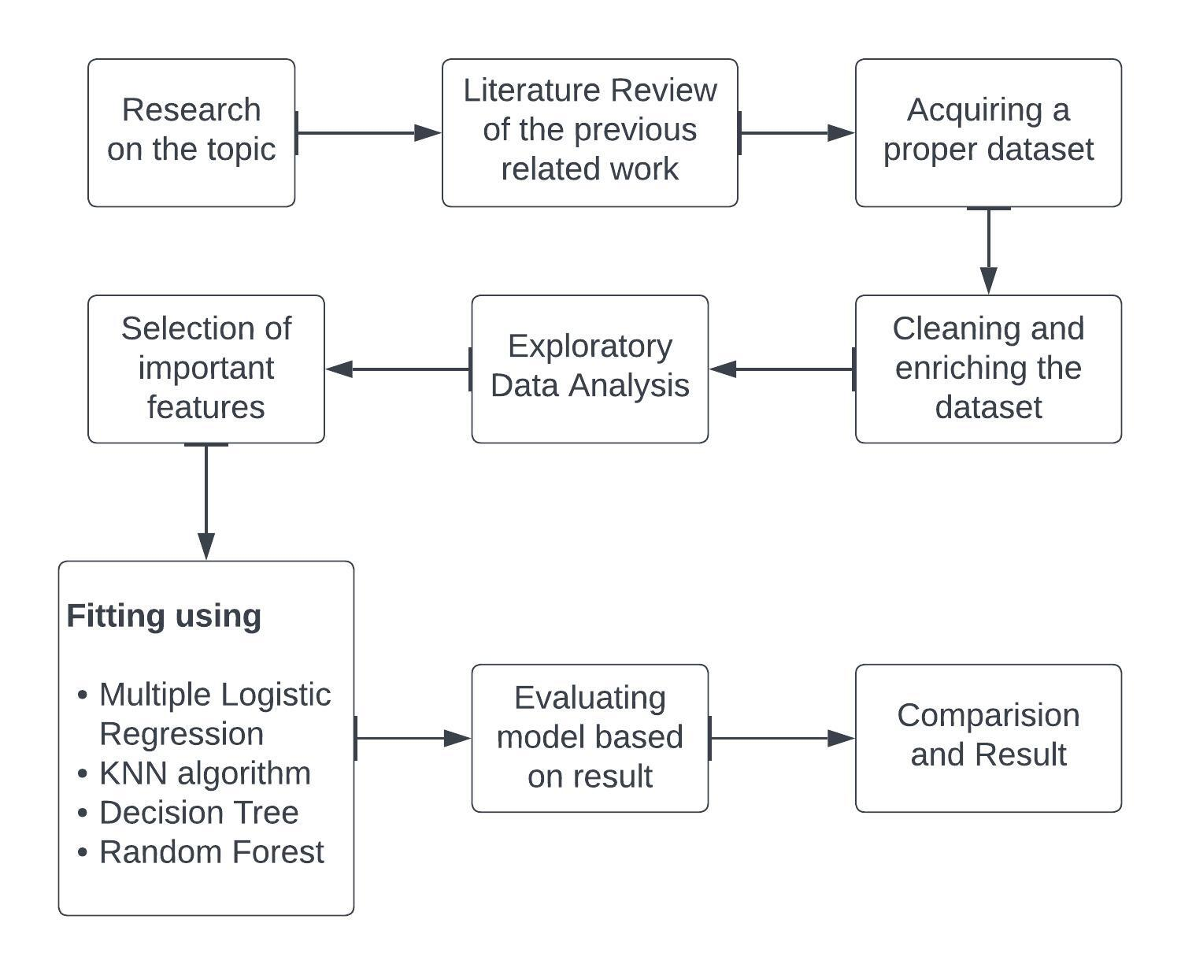
What comes next:

Slide 6
Dataset
The data used for this analysis come from askART, an online artwork database which contains auction records dating back to 1987 and features over 350,000 artists . This analysis is based on the auction records at Sotheby’s and Christie’s the two most well-known international auction houses in Hong Kong from 2016 to 2020.

Slide 7
Given parameters
Parameter | Meaning
sales_price | The price of the artwork
sales_price_log | Log of price on base e.
estimate_range | Estimated price of the artwork based on lower estimate and higher estimate
surface | Surface area of the artwork.
auction_location | Honk Kong – Sotheby’s and Christie’s.
Auction_month | Month of the auction
Canvas oil acrylic board paper lacquer Masonite panel ink wood | Denoted by 0 and 1, for the absence and presence of the attribute.
auction_weekday | On which day of the week the selling was made

Slide 8
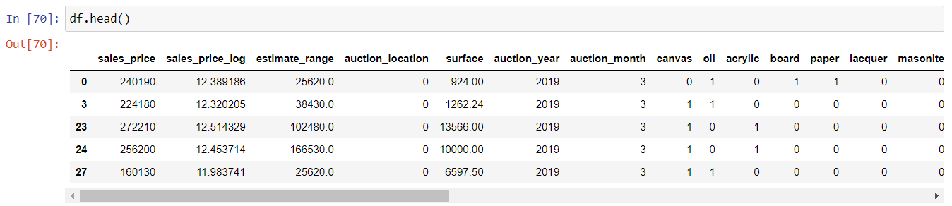
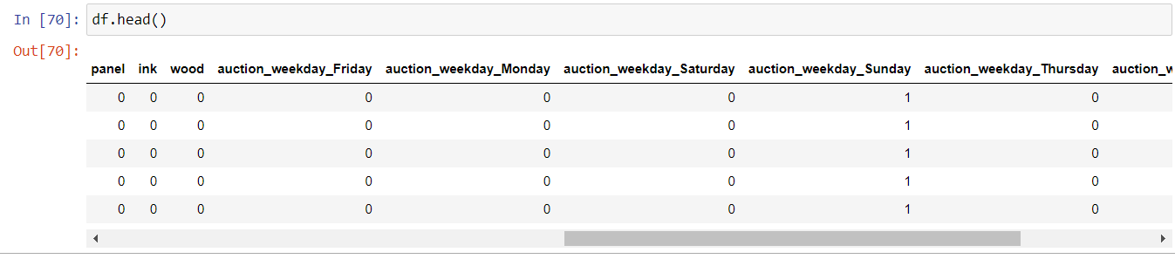
Dataset in use:

Slide 9
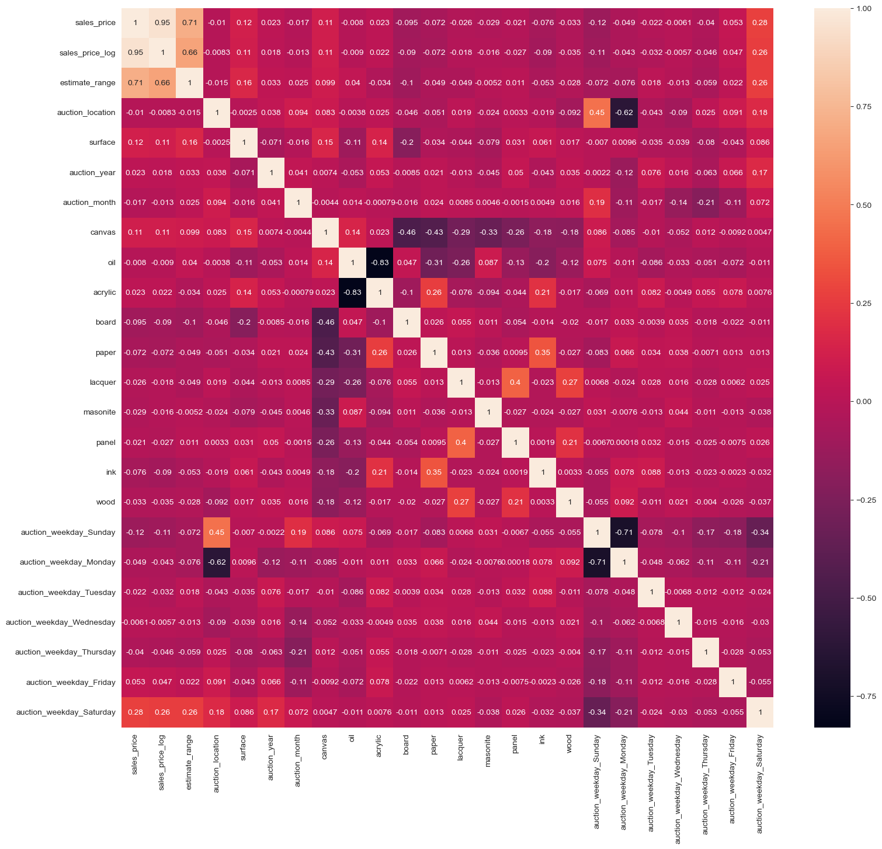
Cor-relation matrix in consideration
This tells us the positive correlation and negative correlation of attributes on the sales_price.

Slide 10
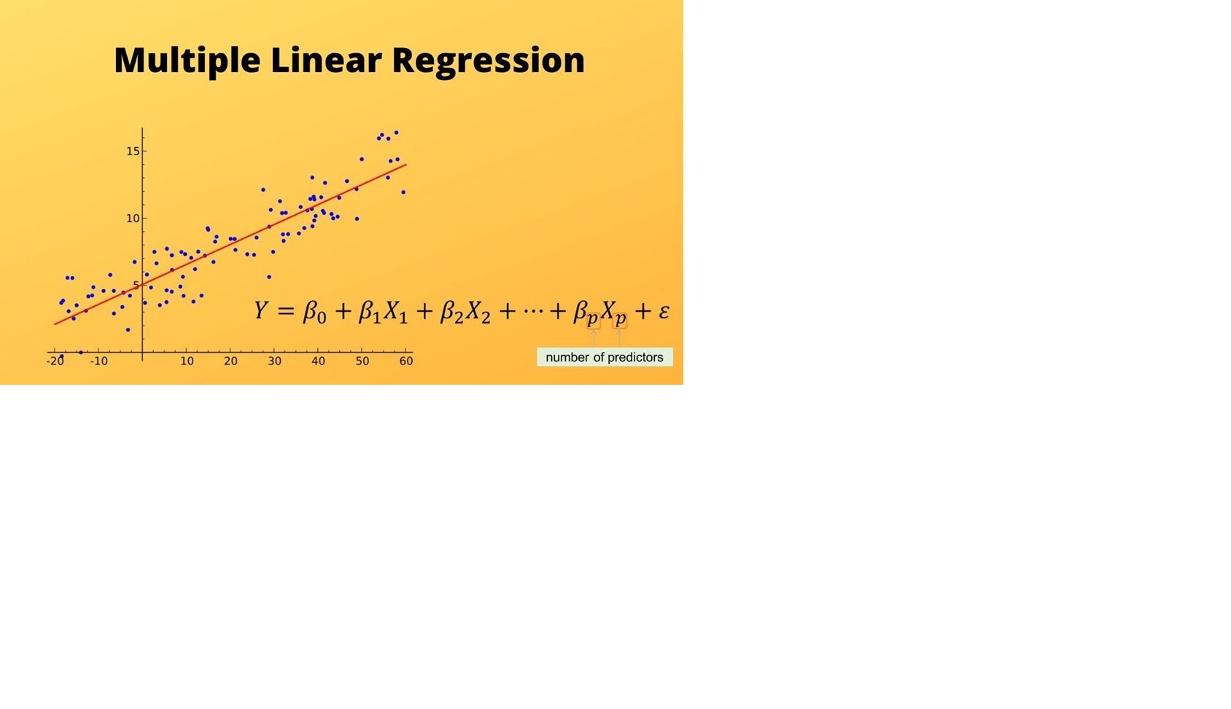
Model Used : Multiple Linear Regression
Y= Output/Response variable
β₀, β ₁, β ₂, β ₃ , β _{n}....= Coefficients of the model.
X₁, X₂, X₃, X₄,...= Various Independent/feature variable

Slide 11
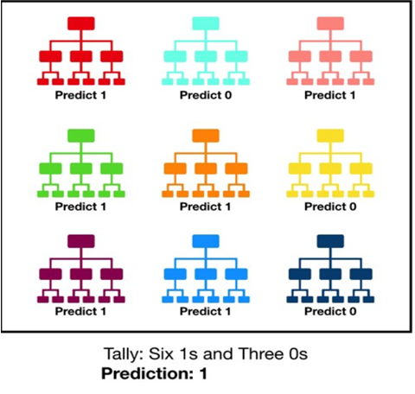
Better Model in Play; Random Forest
There needs to be some actual signal in our features so that models built using those features do better than random guessing.
The predictions (and therefore the errors) made by the individual trees need to have low correlations with each other.

Slide 12
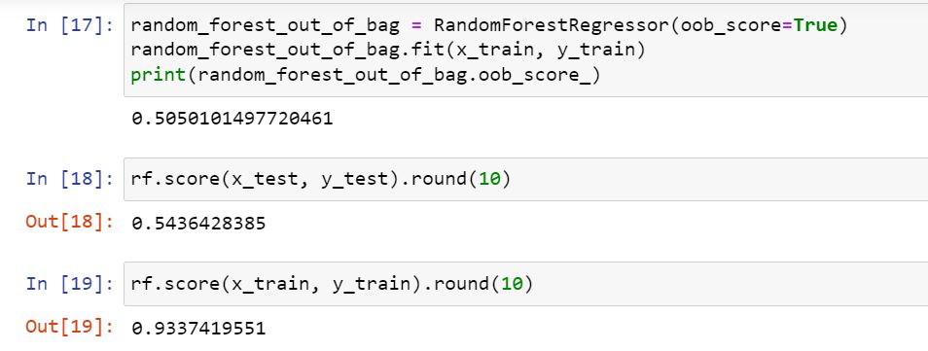
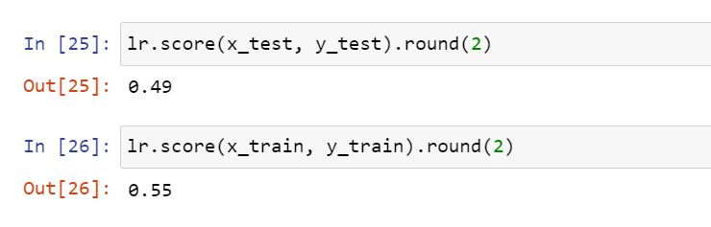
Results Drawn (to work)
R2 score of:
Multiple Linear Regression Vs Random Forest
R2 score used in Random Forest(r2 score 0.933) is higher than Multiple Linear Regression model (where r2 score 0.55)

Slide 13
Advantage
Current advantage drawn are:
Ability to identify patterns and correlations in the data that may be difficult for humans to detect.
Can take into account a wide range of factors and variables that contribute to the value of artwork, resulting in a more comprehensive and accurate appraisal.
Can be trained and refined over time, improving its accuracy and reliability.
Can help to standardize the appraisal process, ensuring consistency and reducing the potential for human error and bias.
Can provide transparency and interpretability in the appraisal process, allowing users to understand how the model arrived at its valuation and identify any potential errors or biases.
Can be used to evaluate a large number of artworks in a relatively short amount of time, increasing the efficiency of the appraisal process.

Slide 14
Way to go ahead
Optimising model further.
Deployment of the website for the same.

Slide 15
References
Sotheby’s http://www.sothebys.com/en/inside/about-us.html
Christie’s Buying Guide http://www.christies.com/features/guides/buying/ forms/How%20to%20Buy%20NY.pdf.
Ashenfelter, Orley and Kathryn Graddy (2011), “Sale rates and price movements in art auctions.” American Economic Review, 101, 212–216, URL http://www.aeaweb.org/articles?id=10.1257/ aer.101.3.212.
Jason Bailey. Can machine learning predict the price of art at auction? Harvard Data Science Re-view, Apr 2020. doi: 10.1162/99608f92.7f90ce96.
Rafi Ayub, Cedric Orban, and Vidush Mukund. Art appraisal using convolutional neural networks. Dec 2017.
solaris-2578/Art-Auction-Price-Prediction url solaris-2578/Art-Auction-Price-Prediction: final-project-solaris-2578 created by GitHub Classroom

Slide 16
References
Nona Tepper. How artnome uses machine learning to predict the price of an artistic masterpiece, Apr 2020. URL https://builtin.com/machine-learning/ artnome-boston-machine-learning.
Christie’s http://www.christies.com/about-us/company/overview/
Aubry, M., Kräussl, R., Manso, G., Spaenjers, C. (2019). Machines and Masterpieces: Predicting Prices in the Art Auction Market. Available at SSRN 3347175
Devin Liu and Doug Woodham, Using AI to Predict Rothko Paintings’ Auction Prices, May 7, 2019, Artsy,https://www.artsy.net/article/artsy-editorial-ai-predict-rothko-paintings-auction-prices
Understanding Random Forest. How the Algorithm Works and Why it Is… | by Tony Yiu | Towards Data Science. (n.d.). Retrieved June 1, 2022, from https://towardsdatascience.com/understanding-random-forest-58381e0602d2
Flow chart made on https://www.lucidchart.com/pages/examples/flowchart-maker

Slide 17
Thank you

